Slide 1

Azubi Sales Dashoboard

Slide 2
Power BI Dashboard Project Kick-off Agenda
Introduction
Welcome to the comprehensive report detailing the culmination of our efforts in the Power BI Dashboard Project, a venture assigned by getINNOtized to design and deliver an end-to-end business intelligence solution. Our esteemed client has collected transactional data for the entirety of the year 2019 but has yet to leverage its full potential for strategic decision-making.
In this report, we will delve into the intricacies of our data analysis journey, aiming to unearth valuable insights that will empower our client to not only comprehend their financial landscape but also pinpoint opportunities for driving increased sales and operational efficiency.

Slide 3

The client's pressing questions serve as the guiding pillars of our investigation:
Total Revenue for the Year:
Quantifying the financial success of the business throughout 2019.
Seasonality in Sales:
Identifying patterns and trends within the sales data to unveil any seasonal influences.
Best and Worst-Selling Products:
Determining which products have excelled and those that require attention.

Slide 4
Cntd....
Sales Comparison Over Time:
Analyzing the trajectory of sales in the latter half of the year in comparison to previous periods.
Product Delivery Distribution:
Locating the cities where the majority of product deliveries are concentrated.
Product Categories Analysis:
Comparing different product categories based on revenue generated and quantities ordered.
Additional Insights:
Unveiling hidden gems and additional details discovered during our comprehensive analysis.

Slide 5

Cntd....
We navigated through diverse data sources, including Excel files for the initial six months and a remote database for the latter half. Our journey involved meticulous data cleaning, integration, and transformation to ensure the reliability of our findings.
This report encapsulates not only the numerical revelations from our data but also the strategic implications these insights carry for our client's future endeavors. Join us as we unfold the narrative of transforming raw data into actionable intelligence, facilitating informed decision-making and strategic business growth.

Slide 6
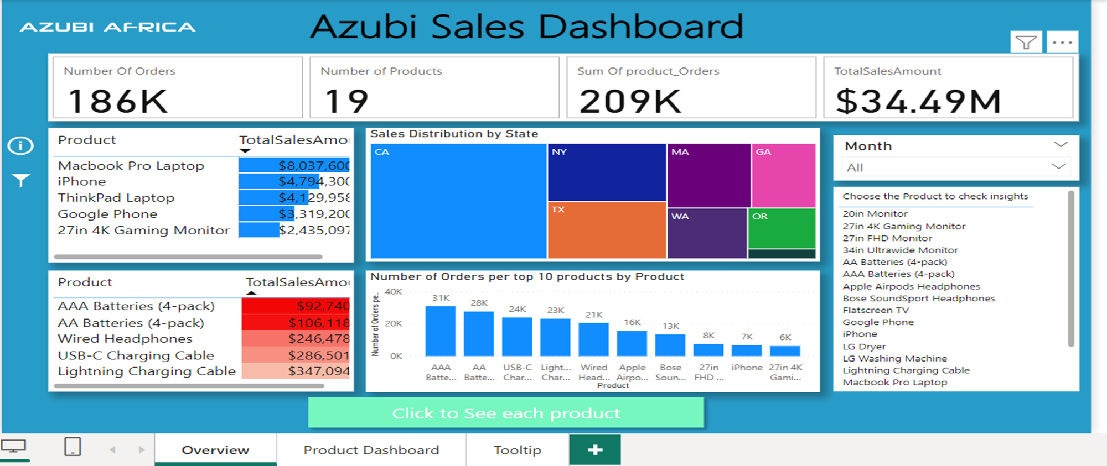
General Overview

Slide 7
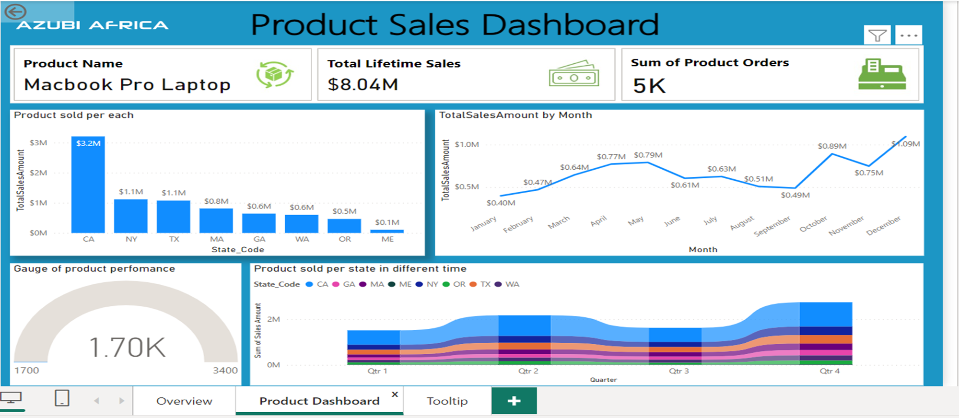
Product Dashboard

Slide 8
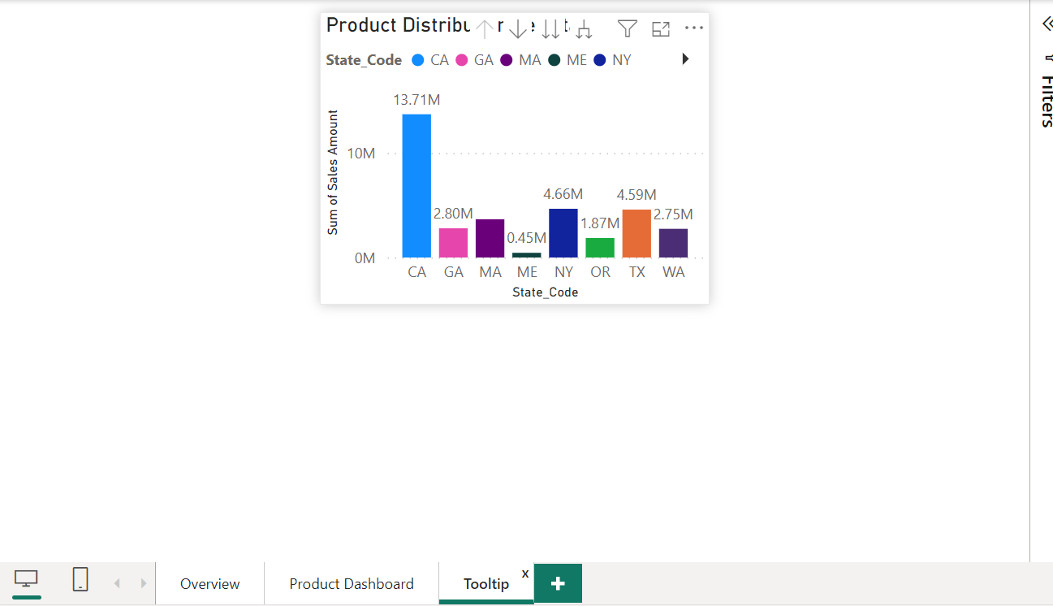
Tooltip

Slide 9
Challenges Faced by the Client:
Underutilization of Data:
The client has struggled to harness the full potential of their transactional data, hindering their ability to make informed strategic decisions.
Opportunities for Improvement:
Despite having rich datasets, the client lacks a structured approach to identify growth opportunities, optimize sales, and enhance operational efficiency.

Slide 10
Client Background and Objectives
Client Background:
Our client, a dynamic entity in the business landscape, has amassed a wealth of transactional data spanning the entire year of 2019. Despite the abundance of this data, the client faces the challenge of untapping its full potential to drive informed decision-making. The organization has recognized the need for a strategic approach to data analysis and has enlisted our expertise to unlock the insights embedded within their datasets.

Slide 11
Expected Outcomes:
The client aspires to receive a comprehensive report that not only answers their specific questions but also provides additional insights to drive actionable strategies. By the end of this project, the client envisions having a robust business intelligence solution that empowers them to make data-driven decisions, capitalize on opportunities, and optimize their operations for sustained growth.

Slide 12

Scope:
The project will encompass the comprehensive analysis of transactional data collected during the entire year of 2019. To provide a clear framework for our efforts, we have identified the following key components within the project scope:

Slide 13
Cntd....
Data Integration:
Collect and integrate transactional data from both the initial six months, stored in Excel files, and the subsequent six months, located in a remote database.
Data Cleaning and Transformation:
Ensure data integrity by addressing any inconsistencies, missing values, or duplicates.
Label products based on unit prices as high-level or basic as per the defined criteria.
Power BI Dashboard Development:
Create a dynamic and interactive Power BI dashboard to visualize key insights derived from the data.

Slide 14
Cntd....
Answering Client Questions:
Address the client's specific questions, including total revenue, seasonality identification, best and worst-selling products, sales comparisons, geographic distribution, and product categories analysis.
Additional Insights:
Uncover and present additional insights from the data, offering valuable perspectives beyond the client's specific queries.

Slide 15

Project Plan and Timeline
The project was executed within a period of two weeks. We divided the project to four phases, i.e
Phase 1: Data Collection and Integration
Phase 2: Data Cleaning and Transformation
Phase 3: Power BI Dashboard Development
Phase 4: Analysis, Reporting, Review and Submission.
The first two phases were executed during the first week while the last two phases were executed in the last one week.

Slide 16

END

